Slide 1



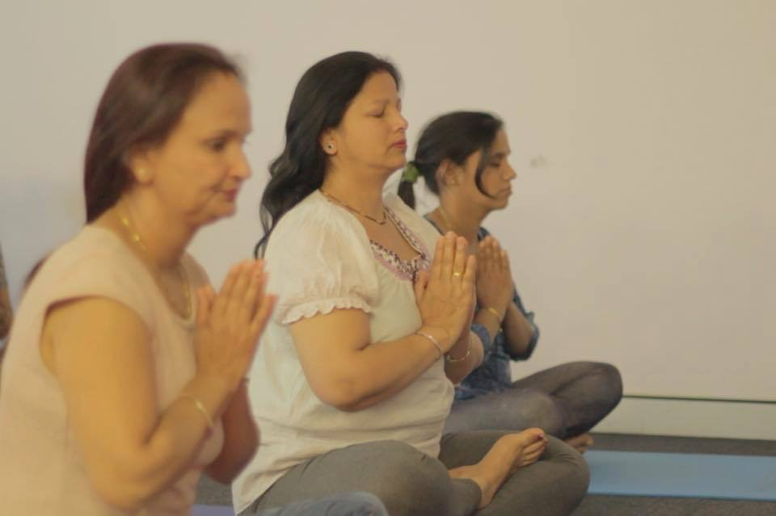
Yoga for Refugees Healing from Torture and Trauma: A Mixed Methods Evaluation
Danielle Begg, Helen Bibby, Tonet Ortega, David Perez, Kedar Maharjan & Mariano Coello
Notes:
Hello. My name is (insert name) and I am the (insert job title) at STARTTS. In this short presentation I am going to explain to you a little bit about STARTTS, who we work with and why, and how service providers can refer clients to STARTTS. I will also explain how STARTTS can support you.

Slide 2
Refugee Yoga Project
Hosts weekly yoga classes to groups of refugees healing from torture and trauma in Sydney, Australia
In 2016, 191 yoga classes were taught to over 200 refugees in six locations
This evaluation was conducted by the New South Wales Service for the Treatment and Rehabilitation of Torture and Trauma Survivors
For more information, or to access yoga videos in Arabic, English, Tamil & Nepali visit:
www.refugeeyogaproject.com

Slide 3

Background
Refugees at risk of psychological complications due to high levels of cumulative trauma (Fazel & Stein, 2002)
PTSD & depression among the most common mental health problems (Fazel, Wheeler & Danesh, 2005; Steel et al., 2009)
Increasing recognition of the importance of brain & body in development & maintenance of symptoms (van der Kolk et al., 2014)
Increasing interest in mind-body therapies as part of multi-modal treatment for PTSD (Metcalf et al, 2016)

Slide 4

Previous Research (1)
Little published research on the use of yoga with refugees
Promising findings in other traumatised populations:
  Reduced PTSD symptoms in US women (Mitchell et al, 2014; van der Kolk et al., 2014)
  Reduced PTSD symptoms & depression in male Vietnam veterans (Carter & Byrne, 2004; Johnston et al., 2015)
Other suggested benefits for trauma survivors:
  Physical symptoms & general health
  Sleep
  Stress
  Resilience
  (Brown & Gerbarg, 2005; Jindani, 2015;
  Jindani & Khalsa, 2015; Staples, Hamilton & Uddo, 2013)

Slide 5
Previous Research (2)
Mechanisms of effect yet to be determined. Hypotheses include:
  Reduced hyperarousal via nervous system regulation (Johnston et al., 2015; Pradhan et al., 2016; Staples et al., 2013)
  Increased psychological flexibility (Dick et al.,2014)
  Improved body awareness and tolerance of physical sensations (van der Kolk et al., 2014)

Slide 6
Pilot Program
Two month pilot conducted with 64 refugees & asylum seekers in Sydney in collaboration with:
  STARTTS
  SydWest Multicultural Services
  Settlement Services International
  Asylum Seekers Centre
  Villawood Immigration Detention Centre
Attendance records support feasibility
Qualitative feedback
  Relaxation
  Improved mood
  Reduced pain

Slide 7
Program Description
Weekly one hour yoga classes offered to groups of refugees
Referrals come from STARTTS & affiliated organisations
Classes held in Western & South Western Sydney
Groups conducted by a qualified yoga instructor and STARTTS counsellors, assisted by an interpreter
Classes consist of
  Breathing exercises
  Gentle yoga poses
  Guided relaxation
Each class tailored to the needs of the group

Slide 8
Yoga Groups (Adult)
Group | n | Age Group | Language | Ethnicity
Blacktown SydWest Men* | 19 | Adult | Nepali | Bhutanese
Blacktown SydWest Women | 27 | Adult | Nepali | Bhutanese
Carramar STARTTS | 40 | Adult | Arabic | Chaldean
Liverpool Mandaean Centre | 22 | Adult | Arabic | Mandaean
Liverpool Refugee Health | 16 | Adult | Arabic | Mandaean
Mt Druitt Com. Health* | 10 | Adult | Arabic | Mixed
Toongabbie Com. Centre | 35 | Adult | Tamil | Tamil
* Shorter group: Data was only collected at two time-points

Slide 9

Aims
Program aims
Inspire psychological calm through focus on breath
Improve physical well-being, body awareness & relaxation through movement
Improve mind-body connection by providing a safe place for participants to explore themselves
Evaluation aims
Further assess feasibility & acceptability for refugee participants
Identify any physiological, psychological or interpersonal benefits participants
Explore counsellor & participant attitudes & opinions

Slide 10

Measures (1)
Process measures (weekly)
  Attendance records
  Satisfaction ratings
Psychological questionnaires
  Harvard Trauma Questionnaire: Part IV (HTQ) (Mollica et al., 1992)
  Hopkins Symptom Checklist (HSCL) (Parloff et al., 1954)
  Freiburg Mindfulness Inventory* (FMI) (Walach et al., 2006)
  * Selected groups only

Slide 11
Measures (2)
Physiological measures
  Fitness Assessment
    Hand grip (Roberts et al., 2011)
    Reaction time (Eckner et al., 2009)
    Standing balance (Springer et al., 2007)
  Heart Rate Variability (HRV) (emWave)
Qualitative evaluation
  Counsellor interviews
  Participant focus groups

Slide 12
Data Collection Schedule (Feb-Oct 2016)
Baseline
Fitness & HRV
Mid-point
HRV
End-point
Fitness & HRV
HTQ & HSCL
HTQ & HSCL
HTQ & HSCL
FMI
Qualitative
FMI
Qualitative

Slide 13
Participants
Characteristic | (n=188)
Gender | Female | 90%
Age (years) | M (SD) | 47.1 (16.2)
Country of birth | Iraq Bhutan Sri Lanka Other* | 49% 27% 19.5% 4.5%
Years in Australia | M (SD) | 5.8 (4.2)
Residential status | Permanent resident or citizen Asylum seeker or TPV holder | 80.5% 19.5%
Clinical levels of mental health symptoms | PTSD Depression Anxiety | 46% 49% 58%
* Other countries of birth: Indonesia, Iran, Morroco, Pakistan, Syria

Slide 14
Percent attendance of those enrolled
Average number of sessions attended by
  Mid-point: 4.7 (SD= 2.6) Range = 0-11
  End-point: 6.2 (SD=4.1) Range = 0-17

Slide 15
Average Weekly Satisfaction Ratings
☺
😐
☹
Satisfaction was predicted by
  Gender (t=-2.599, p<0.05)
  Poorer balance at baseline (r=0.52, p<0.05)
It was not associated with baseline psychological results or attendance

Slide 16
PTSD Symptoms
This relationship was still found if FMI scores was held constant, but not if baseline HRV score was held constant
Number of yoga sessions attended was a significant predictor of end-point HTQ score*
  Model: F_{3,13}= 17.819, p <0.001 Adjusted R square = 0.759
  Predictor: Unstandardised ß = -0.11, p<0.01
  * Controlling for baseline HTQ score & age

Slide 17
Depression
This relationship was still found if FMI or HRV scores were held constant
Number of yoga sessions attended was a significant predictor of end-point HSCL Depression score*
  Model: F_{3,19}= 10.143, p <0.001 Adjusted R square = 0.555
  Predictor: Unstandardised ß = -0.08, p<0.05
  * Controlling for baseline HSCL Depression & age

Slide 18
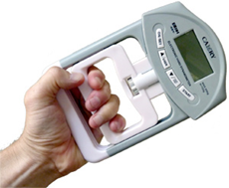
Physiological Measures
Heart Rate Variability
Number of yoga sessions attended did not appear to predict end-point HRV scores
However, there was some evidence of a relationship between HRV scores and PTSD symptoms
Fitness Assessment
No evidence of a relationship between number of sessions attended and any fitness assessment measures
Unable to examine the impact of home practice

Slide 19
Qualitative Findings: Perceived Benefits
“In the past, I used to be very anxious all the time and very nervous. I used to not be able to breathe as I do now. And now I am much better. Like, when I go to sleep, I practice breathing in and out. I am practicing my breathing every single night… and it helps me relax and calm down.”
(Mandean group)
“The pain hasn’t disappeared completely but definitely it has gone better and with the flexibility of the body, we are more active.”
(Bhutanese women’s group)
Category | Themes
Physical | Improved ability to perform poses/flexibility Reduced pain/pain management Improved sleep
Psychological | Feeling calm & relaxed Able to cope with stress/anxiety Anger management Increased insight/awarenss
Social | Enhanced confidence/self-concept Sense of pride & belonging in group Having fun/enjoyment
“Yoga helped to improve communication, relationship, improvement in memory… We built a close relationship, we are like a family now. Through this program, relationship became stronger. Yoga helps us with all aspects…”
(Mandaean group)
“After coming to this group… poses that looked impossible for us before … seems like nothing is impossible, and we can do that as a group”
(Bhutanese men’s group)

Slide 20
Conclusions
Attending more yoga sessions predicts lower PTSD and depression symptoms
  Not attributable to age or baseline symptoms
  No evidence for mindfulness as mechanism of effect
  Baseline CNS regulation may play a role
Participants and counsellors perceived a range of benefits
  Physical
  Psychological
  Social

Slide 21

Lessons Learned & Future Plans
Tailoring intervention to different ages & ability levels
Importance of suitable venue & consistent interpreter
Unanswered questions
  More rigorous evidence needed for effectiveness
  Active components of treatment
  Predictors of outcome
Methodological improvements for research
  Comparison group (e.g. exercise/lifestyle)
  Individual assessment sessions
  Record home practice
  Find ways to facilitate attendance

Slide 22
Vasudhara Foundation
Yoga program at STARTTS was funded by the Vasudhara Foundation
The Foundation supports early-stage, innovative and creative social impact projects
Broad range of interests including:
  Yoga
  Meditation
  Projects that support refugees in Australia
http://www.vasudharafoundation.org/

Slide 23
References (1)
Brown, R. P., & Gerbarg, P. L. (2005). Sudarshan Kriya Yogic breathing in the treatment of stress, anxiety, and depression. Part II--clinical applications and guidelines. J Altern Complement Med, 11(4), 711-717.
Carter, J., & Byrne, G. (2004). A two year study of the use of yoga in a series of pilot studies as an adjunct to ordinary psychiatric treatment in a group of Vietnam War veterans suffering from post traumatic stress disorder. Retrieved from www.Therapywithyoga.com.
Dick, A. M., Niles, B. L., Street, A. E., DiMartino, D. M., & Mitchell, K. S. (2014). Examining mechanisms of change in a yoga intervention for women: The influence of mindfulness, psychological flexibility, and emotion regulation on PTSD symptoms. Journal of Clinical Psychology, 70(12), 1170-1182.
Eckner, J. T., Whitacre, R. D., Kirsch, N. L., & Richardson, J. K. (2009). Evaluating a clinical measure of reaction time: an observational study. Percept Mot Skills, 108(3), 717-720.
Fazel, M., & Stein, A. (2002). The mental health of refugee children. Archives of Disease in Childhood, 87(5), 366-370.
Fazel, M., Wheeler, J., & Danesh, J. (2005). Prevalence of serious mental disorder in 7000 refugees resettled in western countries: a systematic review. The Lancet, 365(9467), 1309-1314.
Jindani, F. (2015). Explorations of wellness and resilience: A yoga intervention for post-traumatic stress. Dissertation Abstracts International: Section B: The Sciences and Engineering, 76(4-B(E)),
Jindani, F., & Khalsa, G. (2015). A yoga intervention program for patients suffering from symptoms of posttraumatic stress disorder: A qualitative descriptive study. The Journal of Alternative and Complementary Medicine, 21(7), 401-408.

Slide 24
References (2)
Johnston, J. M., Minami, T., Greenwald, D., Li, C., Reinhardt, K., & Khalsa, S. B. S. (2015). Yoga for military service personnel with PTSD: A single arm study. Psychological Trauma: Theory, Research, Practice, and Policy, 7(6), 555-562.
Metcalf, O., Varker, T., Forbes, D., Phelps, A., Dell, L., et al. (2016). Efficacy of fifteen emerging interventions for the treatment of posttraumatic stress disorder: A systematic review. Journal of Traumatic Stress, 88-92.
Mitchell, K. S., Dick, A. M., DiMartino, D. M., Smith, B. N., Niles, B., Koenen, K. C., & Street, A. (2014). A pilot study of a randomized controlled trial of yoga as an intervention for PTSD symptoms in women. Journal of Traumatic Stress, 27(2), 121-128.
Mollica, R. F., Caspi-Yavin, Y., Bollini, P., Truong, T., Tor, S., & Lavelle, J. (1992). The Harvard Trauma Questionnaire. Validating a cross-cultural instrument for measuring torture, trauma, and posttraumatic stress disorder in Indochinese refugees. J Nerv Ment Dis, 180(2), 111-116.
Ourmala. (2016). Ourmala: Yoga for referees. Retrieved from http://www.ourmala.com/yogaforrefugees/
Parloff, M. B., Kelman, H. C., & Frank, J. D. (1954). Comfort, effectiveness, and self-awareness as criteria of improvement in psychotherapy. Am J Psychiatry, 111(5), 343-352.
Pradhan, B., D'Amico, J. K., Makani, R., & Parikh, T. (2016). Nonconventional interventions for chronic post-traumatic stress disorder: Ketamine, repetitive trans-cranial magnetic stimulation (rTMS), and alternative approaches. Journal of Trauma & Dissociation, 17(1), 35-54.

Slide 25
References (3)
Roberts, H. C., Denison, H. J., Martin, H. J., Patel, H. P., Syddall, H., Cooper, C., & Sayer, A. A. (2011). A review of the measurement of grip strength in clinical and epidemiological studies: towards a standardised approach. Age Ageing, 40(4), 423-429.
Springer, B. A., Marin, R., Cyhan, T., Roberts, H., & Gill, N. W. (2007). Normative values for the unipedal stance test with eyes open and closed. J Geriatr Phys Ther, 30(1), 8-15.
Staples, J. K., Hamilton, M. F., & Uddo, M. (2013). A yoga program for the symptoms of post-traumatic stress disorder in veterans. Military Medicine, 178(8), 854-860.
Steel, Z., Chey, T., Silove, D., Marnane, C., Bryant, R. A., & van Ommeren, M. (2009). Association of torture and other potentially traumatic events with mental health outcomes among populations exposed to mass conflict and displacement: a systematic review and meta-analysis. Jama, 302(5), 537-549.
van der Kolk, B. A., Stone, L., West, J., Rhodes, A., Emerson, D., Suvak, M., & Spinazzola, J. (2014). Yoga as an adjunctive treatment for posttraumatic stress disorder: A randomized controlled trial. Journal of Clinical Psychiatry, 75(6), e559-e565.
Walach, H., Buchheld, N., Buttenmüller, V., Kleinknecht, N., & Schmidt, S. (2006). Measuring mindfulness—the Freiburg Mindfulness Inventory (FMI). Personality and Individual Differences, 40(8), 1543-1555.

